Slide 1
Malware Analysis CIS-672 Lecture 01: Introduction
Dr. Muhammad Abid,
DCIS, PIEAS

Slide 2
What's Malware?
Malware is a code that performs malicious actions or actions without user consent.
Shapes of Malware:
Executable
Script
Code, e.g. DLL lib or
any other software.

Slide 3
Purpose of Malware
To steal sensitive information,
To spy on the infected system, or
To take control of the system.

Slide 4
How Malware makes it way?
It typically gets into your system without your consent and can be delivered via various communication channels such as
email,
web,
or USB drives.

Slide 5
What is Malware Analysis?
Malware analysis is the study of malware's behavior.
The objective of malware analysis is to understand the working of malware and how to detect and eliminate it.
It involves analyzing the suspect binary in a safe environment to identify its characteristics and functionalities so that better defenses can be built to protect an organization's network.

Slide 6
Malware Analysis Objectives
To determine the nature and purpose of the malware. For example, it can help you determine whether malware is an information stealer, spam bot, keylogger, and so on.
To gain an understanding of how the system was compromised and its impact.
To determine the attacker's intention and motive. For instance, during your analysis, if you find that the malware is stealing banking credentials, then you can deduce that the motive of the attacker is monetary gain.

Slide 7
Malware Analysis Objectives
To identify the network indicators associated with the malware, which can then be used to detect similar infections using network monitoring.
For example, during your analysis, if you determine that a malware contacts a particular domain/IP address, then you can use this domain/IP address to create a signature and monitor the network traffic to identify all the hosts contacting that domain/IP address.

Slide 8
Malware Analysis Objectives
To extract host-based indicators such as filenames, and registry keys, which, in turn, can be used to determine similar infection using host-based monitoring.
For instance, if you learn that a malware creates a registry key, you can use this registry key as an indicator to create a signature, or scan your network to identify the hosts that have the same registry key.

Slide 9
Why study this subject?
Given the increasing number of devices (computers, laptops, servers, mobiles, IoTs devices, sensors, gateways, etc.) being connected to internet & increasing number of cyber attacks on government, military, pubic and private sectors require strongly manpower who are capable of dealing with cyberattacks.

Slide 10
Books
Primary:
Learning Malware Analysis, 2018 By Monnappa
Secondary:
Practical Malware Analysis, 2012 By Sikorski
Advanced Malware Analysis, 2015 By Christopher
Malware Analyst’s Cookbook, 2011 By Hale Ligh

Slide 11
Course Evaluation
Paper reading and Presentation: 10%
Applied Assignment: 20%
Quizzes: 5%
Mid Term Exam: 15%
Final Exam: 50%

Slide 12
Course Contents
Introduction to Malware Analysis
Static Analysis
Dynamic Analysis
Assembly Lang. and Disassembly Primer
Disassembly Using IDA
Debugging Malicious Binaries
Malware Functionalities and Persistence
Code Injection and Hooking
Malware Obfuscation Techniques
Hunting Malware Using Memory Forensics
Detecting Advanced Malware Using Memory Forensics

Slide 13
Prerequisite
You will be much more comfortable in this subject if you know:
Python
X86/ X64 assembly Programming
Windows application programming interface
PE format

Slide 14
Introduction to Malware Analysis

Slide 15
Malicious Actions
Some of the malicious actions performed by malware:
Stealing sensitive information, including personal, business, and financial data
Unauthorized access to the victim's system
Spying on the victims
Sending spam emails
Engaging in distributed-denial-of-service attacks (DDOS)
Locking up the files on the computer and holding them for ransom

Slide 16
Malware Types
Virus or Worm: Malware that is capable of copying itself and spreading to other computers. A virus needs user intervention, whereas a worm can spread without user intervention.
Trojan: Malware that disguises itself as a regular program to trick users to install it on their systems. Once installed, it can perform malicious actions such as stealing sensitive data, uploading files to the attacker's server, or monitoring webcams.
Notes:
-Worms can modify and delete files, and they can even inject additional malicious software onto a computer. Sometimes a computer worm’s purpose is only to make copies of itself over and over — depleting system resources, such as hard drive space or bandwidth, by overloading a shared network. In addition to wreaking havoc on a computer’s resources, worms can also steal data, install a backdoor, and allow a hacker to gain control over a computer and its system settings
How to tell if your computer has a worm
If you suspect your devices are infected with a computer worm, run a virus scan immediately. Even if the scan comes up negative, continue to be proactive by following these steps.
Keep an eye on your hard drive space. When worms repeatedly replicate themselves, they start to use up the free space on your computer.
Monitor speed and performance. Has your computer seemed a little sluggish lately? Are some of your programs crashing or not running properly? That could be a red flag that a worm is eating up your processing power.
Be on the lookout for missing or new files. One function of a computer worm is to delete and replace files on a computer.
Trojan
Once activated, Trojans can enable cyber-criminals to spy on you, steal your sensitive data, and gain backdoor access to your system. These actions can include:
Deleting data
Blocking data
Modifying data
Copying data
Disrupting the performance of computers or computer networks
Unlike computer viruses and worms, Trojans are not able to self-replicate.

Slide 17
Malicious Types
Backdoor / Remote Access Trojan (RAT): This is a type of Trojan that enables the attacker to gain access to and execute commands on the compromised system.
Adware: Malware that presents unwanted advertisements (ads) to the user. They usually get delivered via free downloads and can forcibly install software on your system.

Slide 18
Malicious Types
Botnet: This is a group of computers infected with the same malware (called bots), waiting to receive instructions from the command-and-control server controlled by the attacker. The attacker can then issue a command to these bots, which can perform malicious activities such as DDOS attacks or sending spam emails.

Slide 19
Malicious Types
Information stealer: Malware designed to steal sensitive data such as banking credentials or typed keystrokes from the infected system. Some examples of these malicious programs include key loggers, spyware, sniffers, and form grabbers.
Ransomware: Malware that holds the system for ransom by locking users out of their computer or by encrypting their files.
Notes:
Sniffing is the process of monitoring and capturing all the packets passing through a given network using sniffing tools. It is a form of “tapping phone wires” and get to know about the conversation

Slide 20
Malicious Types
Rootkit: Malware that provides the attacker with privileged access to the infected system and conceals its presence or the presence of other software.
Downloader or dropper: Malware designed to download or install additional malware components
Notes:
-Rootkit
Programs that hide the existence of malware by intercepting (i.e., "Hooking") and modifying operating system API calls that supply system information. Rootkits or rootkit enabling functionality may reside at the user or kernel level in the operating system or lower to include a hypervisor, master boot record, or the system firmware. Adversaries may use rootkits to hide the presence of programs, files, network connections, services, drivers, and other system components. Rootkits have been seen for Windows, Linux, and Mac OS X systems.
-Classifying malware based on their functionalities may not always be possible because a
single malware can contain multiple functionalities, which may fall into a variety of
categories mentioned previously. For example, malware can include a worm component
that scans the network looking for vulnerable systems and can drop another malware
component such as a backdoor or a ransomware upon successful exploitation.

Slide 21
Types Of Malware Analysis
Static analysis:
analyzing a binary without executing it.
allows you to extract the metadata associated with the suspect binary.
might not reveal all the required information, but it can sometimes provide interesting information that helps in determining where to focus your subsequent analysis efforts.

Slide 22
Types Of Malware Analysis
Dynamic analysis (Behavioral Analysis):
executing the suspect binary in an isolated environment and monitoring its behavior.
gives valuable insights into the activity of the binary during its execution.
This analysis technique is useful but does not reveal all the functionalities of the hostile program.
Notes:
Process monitoring: Involves monitoring the process activity and examining the
properties of the result process during malware execution.
File system monitoring: Includes monitoring the real-time file system activity
during malware execution.
Registry monitoring: Involves monitoring the registry keys accessed/modified
and registry data that is being read/written by the malicious binary.
Network monitoring: Involves monitoring the live traffic to and from the system
during malware execution.
Process hacker can be used to explore services, network connections, disk activity, and so on.

Slide 23
Types Of Malware Analysis
Code analysis:
analyzing the code to understand the inner workings of the binary.
Static code analysis involves disassembling the suspect binary and looking at the code to understand the program's behavior, whereas
Dynamic code analysis involves debugging the suspect binary in a controlled manner to understand its functionality.
Code analysis requires an understanding of the programming language and operating system concepts.

Slide 24
Types Of Malware Analysis
Memory analysis:
analyzing the computer's RAM for forensic artifacts.
especially useful to determine the stealth and evasive capabilities of the malware.

Slide 25
Setting Up The Lab Environment
Keep your virtualization software up to date. This is necessary because it might be possible for malware to exploit a vulnerability in the virtualization software, escape from the virtual environment, and infect your host system.
Install a fresh copy of the operating system inside the virtual machine (VM), and do not keep any sensitive information in the virtual machine.

Slide 26
Setting Up The Lab Environment
While analyzing a malware, if you don't want the malware to reach out to the Internet, then you should consider using host-only network configuration mode or restrict your network traffic within your lab environment using simulated services.
Do not connect any removable media that might later be used on the physical machines, such as USB drives.

Slide 27
Setting Up The Lab Environment
Since we will be analyzing Windows malware (typically Executable or DLL), it is recommended to choose a base operating system such as Linux or macOS X for your host machine instead of Windows. This is because, even if a Windows malware escapes from the virtual machine, it will still not be able to infect your host machine.

Slide 28
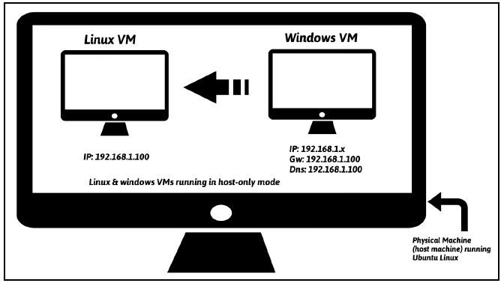
Overview Of Lab Architecture

Slide 29
Overview Of Lab Architecture
Host machine (running Ubuntu 18.04) have instances of Linux virtual machine (running Ubuntu 18.04) & Windows virtual machine (running Windows).
These virtual machines will be configured to be part of the same network and use Host-only network configuration mode so that the malware is not allowed to contact the Internet and network traffic is contained in the isolated lab environment.

Slide 30
Overview Of Lab Architecture
Windows VM is where the malware will be executed during analysis, and
the Linux VM is used to monitor the network traffic and will be configured to simulate Internet services (DNS, HTTP, and so on) to provide an appropriate response when the malware requests for these services.
For example, the Linux VM will be configured such that when the malware requests a service such as DNS, the Linux VM will provide the proper DNS response.

Slide 31
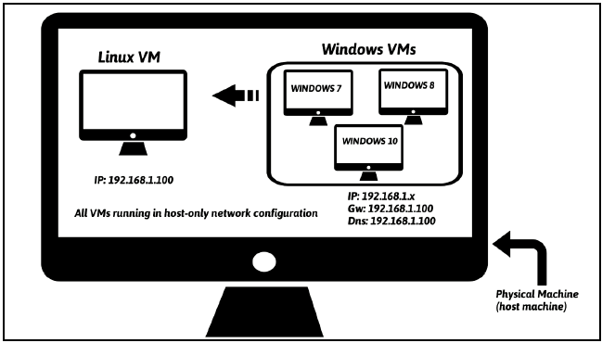
Another Lab Architecture

Slide 32
Setting Up And Configuring Linux VM
Download Ubuntu 18.04 (Desktop image) from http://releases.ubuntu.com/18.04/ and install it in VM VirtualBox 6.1.
Install the Virtualization Tools on Ubuntu
To accomplish this, from the VirtualBox menu, select Devices | Insert guest additions CD image.
Install packages:
$ sudo apt-get update
$ sudo apt-get upgrade
$ sudo apt-get install python-pip
$ pip install --upgrade pip

Slide 33
Setting Up And Configuring Linux VM
$ sudo apt-get install python-magic
$ sudo apt-get install upx
$ sudo pip install pefile
$ sudo apt-get install yara
$ sudo pip install yara-python
$ sudo apt-get install ssdeep
$ sudo apt-get install build-essential libffi-dev python python-dev libfuzzy-dev
$ sudo pip install ssdeep
$ sudo apt-get install wireshark
$ sudo apt-get install tshark
Install INetSim

Slide 34
Setting Up And Configuring Windows VM
Download and install Windows 10 or Windows 7 OS in a virtualBox
Install Python 2.7

Slide 35
Linux and Windows VMs

Slide 36
Linux and Windows VMs

Slide 37
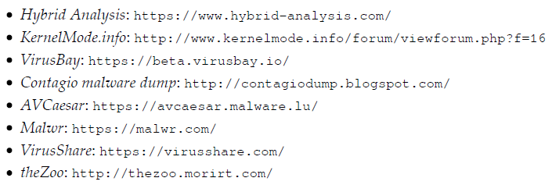
Malware Sources
https://www.virustotal.com/gui/

