Slide 1
Malware Analysis CIS-672 Lecture 06: Dynamic code analysis
Dr. Muhammad Abid,
DCIS, PIEAS

Slide 2
Dynamic Code Analysis
malicious code is executed in a controlled manner under the supervision of a program called debugger
Debugger gives full control over the malware's runtime behavior and allows you to execute
a single instruction,
multiple instructions, or
select functions

Slide 3
Dynamic Code Analysis
When you are debugging a malware, proper care needs to be taken, as you will be running the malicious code on a system.

Slide 4
Debugging a Code
two ways to debug a program:
attach the debugger to a running process
launch a new process
1. Attach the debugger to a running process:
No opportunity to monitor/ control startup and initialization code
the debugger suspends the process
inspect the process's resources or set a breakpoint before resuming the process.

Slide 5
Debugging a Code
2. launch a new process under a debugger
allows you to monitor or debug every action the process takes
the execution will pause at the program's entry point (System, Entry, TLS Callbacks, etc. depending on Options->Preferences->Events settings)
Notes:
On the other hand, launching a new process allows you to monitor or debug every action
the process takes, and you will also be able to monitor the process's initial actions. When
you start the debugger, the original binary will be executed with the privileges of the user
running the debugger. When the process is launched under a debugger, the execution will
pause at the program's entry point. A program's entry point is the address of the first
instruction that will be executed.
///////////
System Breakpoint: When loading a new process, the will cause x64dbg to break in the system function which initializes the application you are attempting to debug. TLS Callbacks: The TLS Callback is a function which is called before the main application runs. This can set parameters or even be used by certain protectors to implement anti-debug technology. This allows you to break on this function. Entry Breakpoint: This causes x64dbg to break on the Entry point on the application. For general debugging, this is the only breakpoint you will need to have checked. DLL Entry: This will break on the entry point of any DLL which is loaded by the process you are debugging. Thread Entry: This will break on the first instruction of any new thread initialized by the current process. Attach Breakpoint: When this is checked, it will cause x64dbg to break in the DbgUiRemoteBreakin function when attaching to an active process. If unchecked, it will attach without suspending the process. DLL Load/DLL Unload: This will break in the system function when a new library(DLL) is loaded into or unloaded from the active process. The DLL Load breakpoint occurs before any of its code is executed. Thread Start/Thread End: This allows us to break in system when our debugged application initializes or terminates a thread.

Slide 6
Controlling Process Execution
The two important capabilities offered by a debugger are:
the ability to control execution, and
the ability to interrupt execution (using breakpoints).

Slide 7
Controlling Process Execution
Common execution control options:
Continue (Run): This executes all of the instructions, until a breakpoint is reached or an exception occurs.
Step into and Step over: you can execute a single instruction.
Execute till Return (Run until return): Using this option inside a function will take you to the end of the function (ret or retn)
Run to cursor (Run until selection): to execute instructions until the current cursor location, or until the selected instruction is reached.
Notes:
The difference between step into and step over occurs when you are executing an instruction that calls a function.

Slide 8
Interrupting a Program with Breakpoints
Breakpoints can be used to
pause the execution at a particular instruction, or
when the program calls a function/API function, or
when the program reads, writes, or executes from a memory address

Slide 9
Interrupting a Program with Breakpoints
Software Breakpoints:
By default, debuggers make use of software breakpoints.
implemented by replacing the instruction at a breakpoint address with a software breakpoint instruction, such as the int 3 instruction (having an opcode of 0xCC).
can set an unlimited number of breakpoints
Notes:
Software Breakpoints
- The disadvantage is that malware can look for the breakpoint instruction (int 3) and modify it to change the normal operation of an attached debugger.

Slide 10
Interrupting a Program with Breakpoints
Hardware Breakpoints:
Support through the use of the CPU's debug registers, e.g. in x86 DR0 - DR7.
maximum of four hardware breakpoints using DR0-DR3; the other remaining debug registers are used to specify additional conditions on each breakpoint.
no instruction is replaced
Notes:
In
the case of hardware breakpoints, no instruction is replaced, but the CPU decides
whether the program should be interrupted, based on the values contained
within the debug registers.

Slide 11
Interrupting a Program with Breakpoints
Memory Breakpoints: These breakpoints allow you to pause the execution when an instruction accesses (reads from or writes to) the memory, rather than the execution.
Conditional Breakpoints: Using conditional breakpoints, you can specify the condition that must be satisfied to pause the breakpoint.
When a breakpoint is reached we say it’s a hit. Unlike other breakpoints, conditional breakpoint pauses execution only when it is a hit and a condition is met

Slide 12
Launching a New Process in x64dbg
Use x64dbg to debug both 32-bit and 64-bit
File | Open and choose a file
the original binary will be executed with the privileges of the user running the debugger.
debugger will pause at the System Breakpoint, the TLS callback, or the program entry point function, etc. depending on the configuration settings (Options | Preferences | Events)

Slide 13
Attaching to an Existing Process Using x64dbg
File | Attach
When the debugger is attached, the process is suspended
File | Detach (attached process is not terminated)
debug privilege settings:
Run the debugger as an administrator;
Options | Preferences | Engine tab, checking the Enable Debug Privilege

Slide 14
x64dbg Debugger Interface

Slide 15
x64dbg Debugger Interface
Disassembly Window (CPU Window):
disassembly of all of the instructions
synchronized with the current value of the instruction pointer register (eip or rip).
display the control flow graph by pressing the G hotkey.
Registers Window:
displays the current state of the CPU registers.
The value in a register can be modified by double-clicking on the register
You can toggle the flag bits on or off by double-clicking on the values of the flag bits.

Slide 16
x64dbg Debugger Interface
Stack Window:
The stack view displays the data contents of the process's runtime stack
Dump Window:
This displays the standard hex dump of the system memory.

Slide 17
x64dbg Debugger Interface
Memory Map Window:
provides the layout of the process memory
a great way to see where the executables and their sections are loaded in the memory.
also contains information about the process DLLs and their sections in the memory
Symbols Window:
display imports and exports with their locations in system memory
Click any module to show its symbols on the right side

Slide 18
x64dbg Debugger Interface
References Window:
displays the references to the API calls.
To populate this window, right-click anywhere in the disassembly (CPU) window, then select Search for | Current Module | Intermodular calls
Handles Window:
to display handles, right-click inside the handles window and select Refresh (or F5).
Notes:
Handles to file, registry, and so on

Slide 19
Controlling Process Execution Using x64dbg

Slide 20
Setting a Breakpoint in x64dbg
Software breakpoint: F2 key (or right-clicking and selecting Breakpoint | Toggle).
Hardware breakpoint: right-click Breakpoint | Set Hardware on Execution.

Slide 21
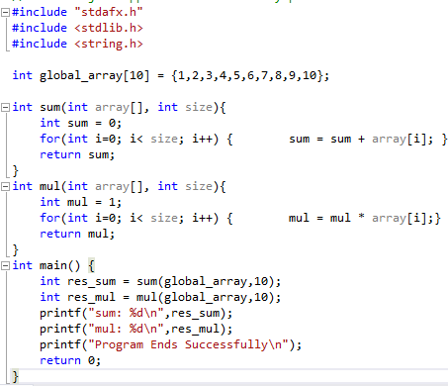
Debugging using X64dbg
Sample Program
Build in MS Visual Studio using Debug Configuration
Notes:
#include "stdafx.h"
#include <stdlib.h>
#include <string.h>
int global_array[10] = {1,2,3,4,5,6,7,8,9,10};
int sum(int array[], int size){
int sum = 0;
for(int i=0; i< size; i++) { sum = sum + array[i]; }
return sum;
}
int mul(int array[], int size){
int mul = 1;
for(int i=0; i< size; i++) { mul = mul * array[i];}
return mul;
}
int main() {
int res_sum = sum(global_array,10);
int res_mul = mul(global_array,10);
printf("sum: %d\n",res_sum);
printf("mul: %d\n",res_mul);
printf("Program Ends Successfully\n");
return 0;
}

Slide 22
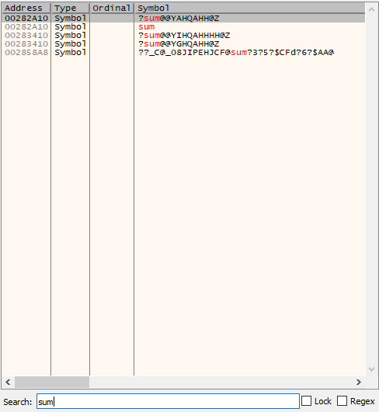
Debugging using X64dbg
Launch previous built program using x32dbg
-Debug file included
-easy to locate sum function– just double click sum symbol

Slide 23
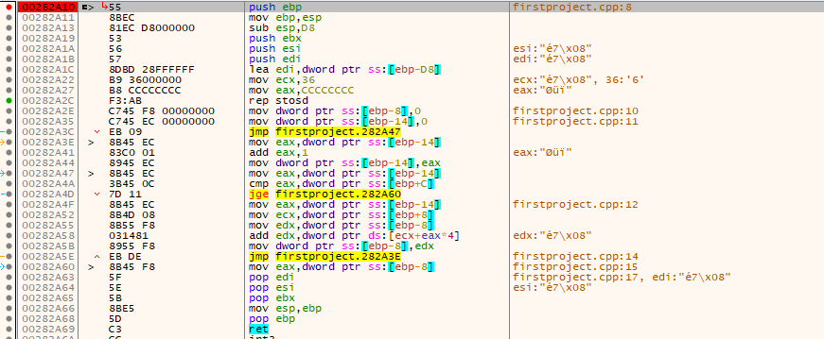
Debugging using X64dbg
Sum function (easily located)

Slide 24
Debugging using X64dbg
Launch previous built program using x32dbg
Debug file removed

Slide 25
Debugging using X64dbg
Now how to locate sum function?
1. References | Functions: generate function references by clicking f_{X}

Slide 26
Debugging using X64dbg
Now search for sum function. Is it sum function?

Slide 27
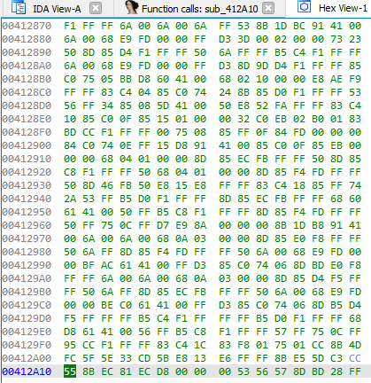
Debugging using X64dbg
2. locate the sum function using IDA Pro
1st step: Find VA of sum

Slide 28
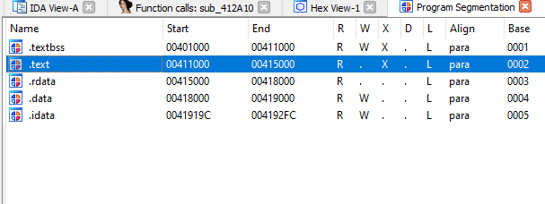
Debugging using X64dbg
2. locate the sum function using IDA Pro
2nd step: Find segment
0041 2A10
0041 1000
0000 1A10
3rd step: file offset from segment beginning

Slide 29
Debugging using X64dbg
2. locate the sum function using IDA Pro
0028 1000 + 0000 1A10 = 0028 2A10
4th step: Add text section base address and difference (3rd step)

Slide 30
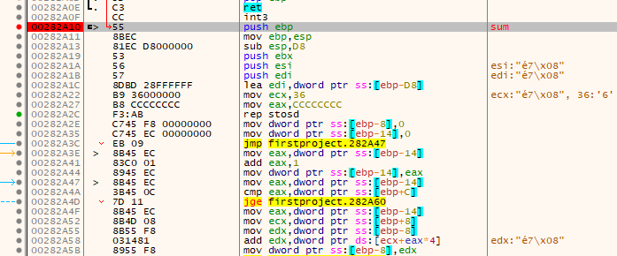
Debugging using X64dbg
Sum function at 0028 2A10

Slide 31
Debugging using X64dbg
Place a breakpoint at the 1st instruction of sum
Run until this breakpoint

Slide 32
Debugging using X64dbg
Call stack
displays the call stack of the current thread
Address: base address of the stack frame where return address (To address) is stored
To: address of next inst. after function call in the caller
From: address in the function that is going to return.
Size: arguments size+ return address size + local variables size.
Comment: a brief description of the call stack frame.
Party: function belongs to user or OS
Notes:
From (address in the caller) matches with To (address in the caller after call instr, i.e. RA )

Slide 33
Debugging using X64dbg
Call stack after breakpoint at the first instruction of sum function

Slide 34
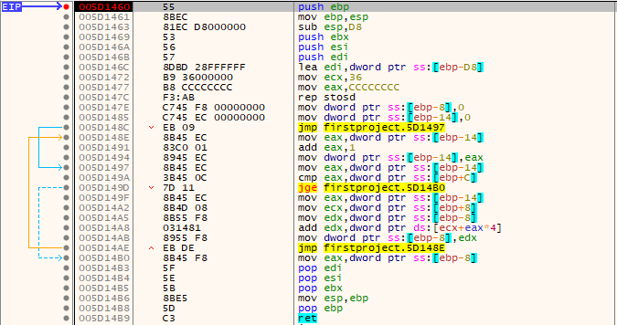
Debugging using X64dbg
Instruction Tracing of sum function: two steps
Sum function
1: Breakpoint @ 1st inst.

Slide 35
Debugging using X64dbg
Instruction Tracing of sum function
2. Determine RA. Specify this address in Break Condition of Trace into/ over
Sum function calling @ address 005D 14F5

Slide 36
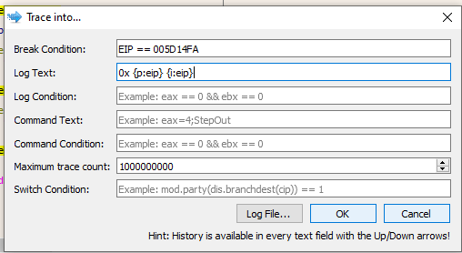
Debugging using X64dbg
Instruction Tracing of sum function

Slide 37
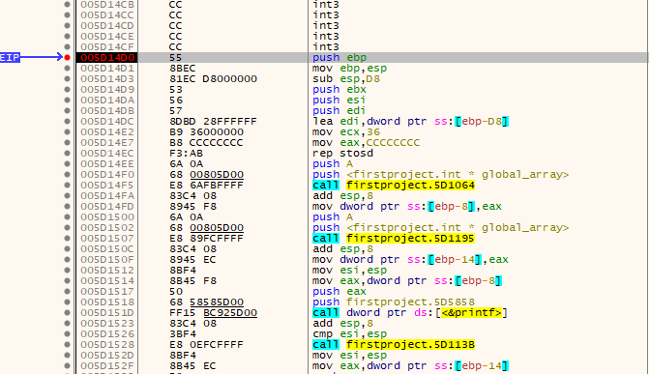
Debugging using X64dbg
Function tracing
All functions called after main() function
1. Find the address of the main() and put breakpoint there

Slide 38
Debugging using X64dbg
Function tracing
2. Find Return Address: Once breakpoint is placed at the 1st instruction of main() restart dubugee using Debug | restart. Run until debugee stops at main’s 1st instruction. Check call stack. main will return at To address once finished execution.
Specify this address in Break Condition of Trace into/ over

Slide 39
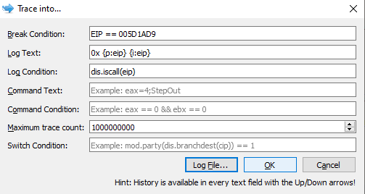
Debugging using X64dbg
Function tracing
Only log function calls

Slide 40
Trace into/ Over log file
Program-visible state of current instruction appears with next instruction in the trace file. E.g. check sub esp, 0xD8 @ address: ox005D14D3.

Slide 41
X64dbg: String Formatting
Printing inst address, instr text, GPRs
0x {p:eip} {i:eip} eax: {x:eax} ebx: {x:ebx} ecx: {x:ecx} edx: {x:edx} eBP: {x:eBP} esp: {x:esp} esi: {x:esi} edi: {x:edi}

Slide 43
Debugging using X64dbg
Memory breakpoint
First find address of memory
Then locate that address in memory dump
In the memory dump right click to address where you want to put memory breakpoint and choose breakpoint
Limitation: Xdbg62 currently (version Nov 05 2020) only supports memory breakpoint at page level so use hardware breakpoint instead

Slide 44
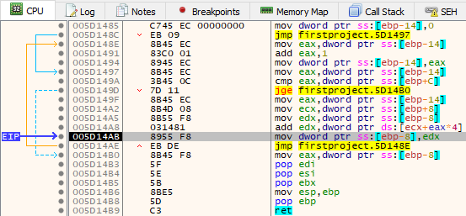
Debugging using X64dbg
Memory access breakpoint at global_array[9]
Use hardware breakpoint as we are interested only in global_array[9]

Slide 45
Debugging using X64dbg
Memory access breakpoint at global_array[9]
Which function’s instruction is accessing global_array[9]?

Slide 46
Debugging a Malicious DLL Using x64dbg
Launch x64dbg (preferably with administrator privileges) and load the DLL (via File | Open).
x64dbg drops an executable (named DLLLoader32_xxxx.exe, where xxxx are random hexadecimal characters) into the same directory where your DLL is located;
DLLLoader32_xxxx.exe acts as a generic host process, which will be used to execute your DLL (in the same manner as rundll32.exe).
Notes:
-After you load the DLL, the debugger may pause at the System Breakpoint, TLS callback, or DLL entry point function, depending on the configuration settings
- An optional entry point into a dynamic-link library (DLL). When the system starts or terminates a process or thread, it calls the entry-point function for each loaded DLL using the first thread of the process. The system also calls the entry-point function for a DLL when it is loaded or unloaded using the LoadLibrary and FreeLibrary functions.

Slide 47
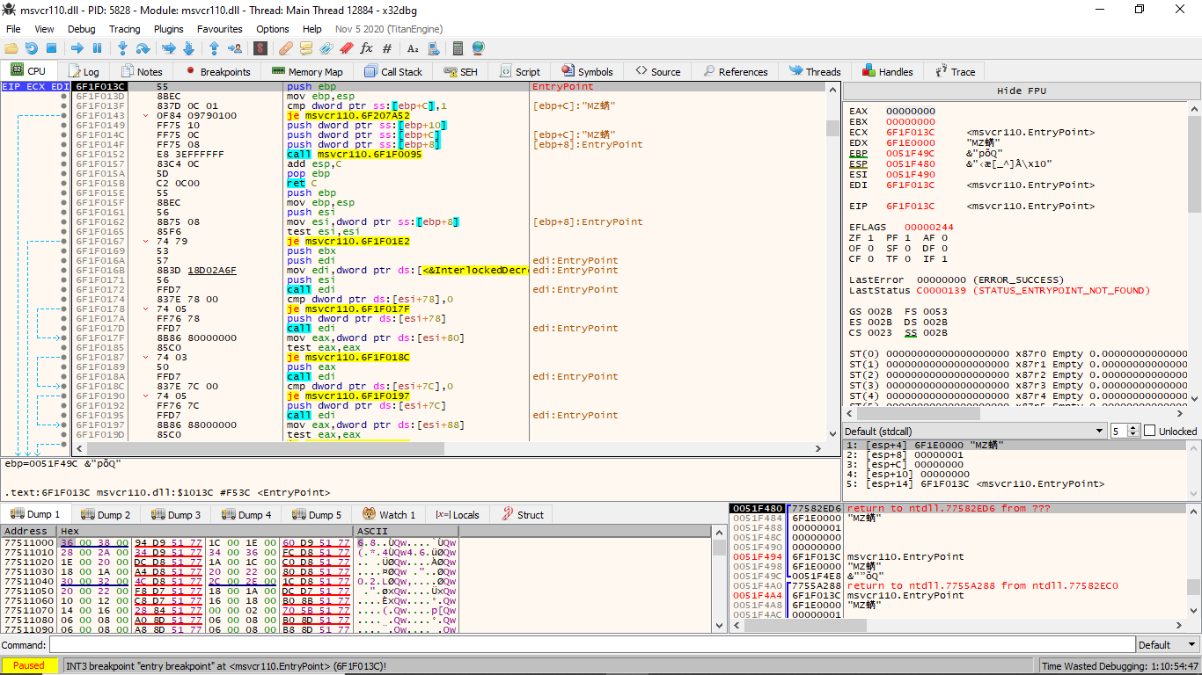
Debugging a Malicious DLL Using x64dbg
Notes:
-First break at System Breakpoint. Until that point msvcr110.dll was not loaded as confirmed from Memory Map
Break at msvcr110.EntryPoint even though DLL Load option in options|Preferences|Events was not checked

Slide 48
Using rundll32.exe to Debug the DLL in x64dbg
load rundll32.exe from the system32 directory (via File | Open) into the debugger
File | change command line
Breakpoints tab | right-click inside the Breakpoints window | Add DLL breakpoint
enter DLL module name.
This will tell the debugger to break when the DLL is loaded
Debug|Restart

Slide 49
Using rundll32.exe to Debug the DLL in x64dbg
Debug | Restart
click Run (F9) multiple times, till you reach the DLL entry point

