Slide 1
Malware Analysis CIS-672
Lecture 03: Inspecting PE Header Information
Dr. Muhammad Abid,
DCIS, PIEAS

Slide 2
PE Format
PE is the native Win32 file format.
Used by Exe, DLLs, COM files, OCX controls, Control Panel Applets (.CPL files), .NET executables, kernel mode drivers, etc.
Notes:
-The term "Portable Executable" was chosen because the intent was to have a
common file format for all flavors of Windows, on all supported CPUs.
-In a packed executable, the import tables are usually destroyed and data is often
encrypted. The packer inserts code to unpack the file in memory upon execution, and then
jumps to the original entry point of the file (where the original program actually starts
executing). If we manage to dump this memory region after the packer finished unpacking
the executable, we still need to fix the sections and import tables before our app will run.
How will we do that if we don’t even know what the PE format is?

Slide 3
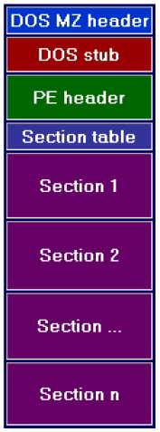
Basic Structure
Structure of a PE file on a disk is exactly the same as when it is loaded into memory.
not copied exactly into memory
Generally size on a disk and memory differs because of alignment.
Notes:
-A very handy aspect of PE files is that the data structures on disk are the same
data structures used in memory. Loading an executable into memory (for example,
by calling LoadLibrary) is primarily a matter of mapping certain ranges of a PE file
into the address space. Thus, a data structure like the IMAGE_NT_HEADERS (which
I'll examine later) is identical on disk and in memory. The key point is that if you
know how to find something in a PE file, you can almost certainly find the same
information when the file is loaded in memory.
-At a minimum, a PE file will have 2 sections; one for code and the other for data. An
application for Windows NT has 9 predefined sections named .text, .bss, .rdata, .data,
.rsrc, .edata, .idata, .pdata, and .debug. Some applications do not need all of these
sections, while others may define still more sections to suit their specific needs.
-Section names are actually irrelevant as they are ignored by the OS and are present only for
the convenience of the programmer

Slide 4
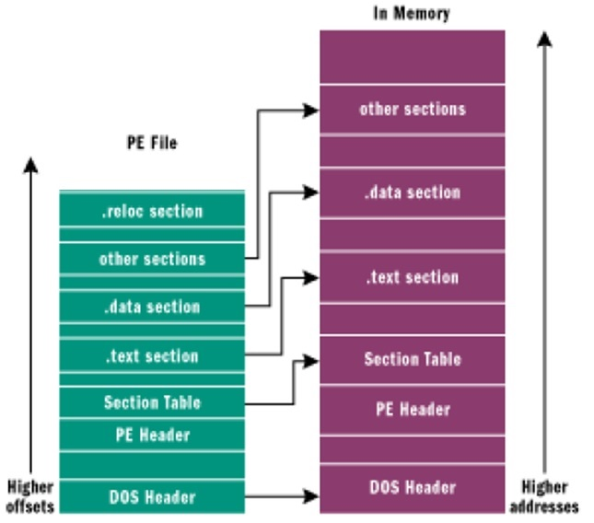
Loading PE file
Notes:
-In computer disk storage, a sector is a subdivision of a track on a magnetic disk or optical disc. Each sector stores a fixed amount of user-accessible data, traditionally 512 bytes for hard disk drives (HDDs) and 2048 bytes for CD-ROMs and DVD-ROMs. Newer HDDs use 4096-byte (4 KiB) sectors, which are known as the Advanced Format (AF).
The sector is the minimum storage unit of a hard drive.^{[1]} Most disk partitioning schemes are designed to have files occupy an integral number of sectors regardless of the file's actual size. Files that do not fill a whole sector will have the remainder of their last sector filled with zeroes. In practice, operating systems typically operate on blocks of data, which may span multiple sectors.^{[2]}
-However it is not copied exactly into memory. The windows loader decides which parts
need mapping in and omits any others. Data that is not mapped in is placed at the end of
the file past any parts that will be mapped in e.g. Debug information.

Slide 5

Sample PE File & Tool
We will use CFF Explorer to analyze PE file
Sample PE File: C:\pestudio\pestudio
Loading PE File:
  Launch
  Load C:\pestudio\pestudio

Slide 6
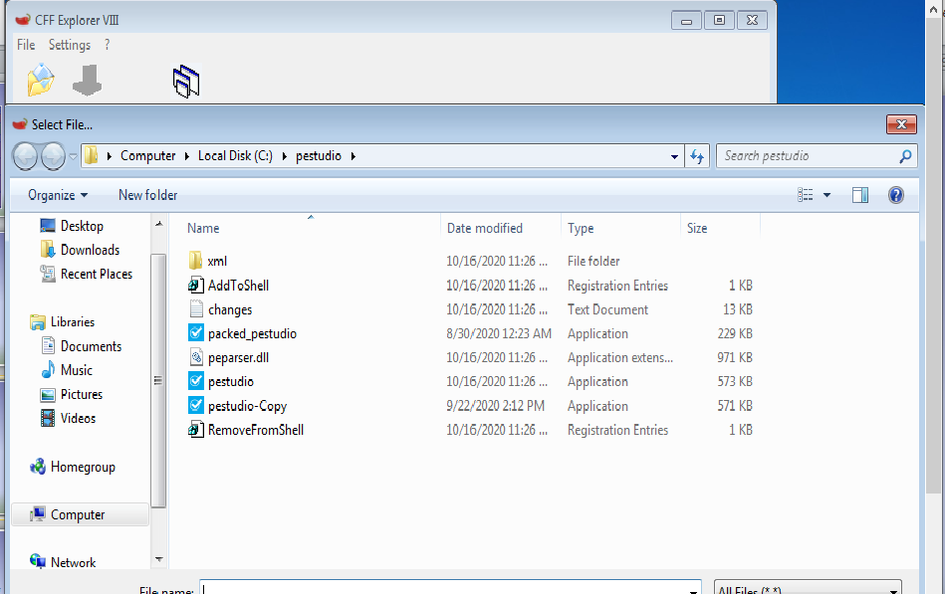
Sample PE File & Tool

Slide 7
The DOS Header
All PE files start with the DOS header
  occupies the first 64 bytes of the file.
  It's there in case the program is run from DOS
  The DOS stub usually just prints a string something like "This program must be run under Microsoft Windows" but it can be a full-blown DOS program.
Notes:
-When building an application for Windows, the linker links a default stub program called WINSTUB.EXE into your executable. You can override
the default linker behavior by substituting your own valid MS-DOS-based program in place
of WINSTUB and using the -STUB: linker option when linking the executable file.

Slide 8
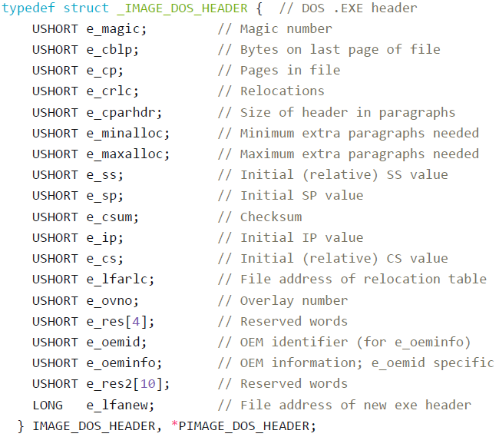
The DOS Header Structure (winnt.h)
64 Bytes
Notes:
-https://docs.microsoft.com/en-us/windows/win32/winprog/windows-data-types
-In the PE file, the magic part of the DOS header contains the value 4Dh, 5Ah (The letters
"MZ" for Mark Zbikowsky one of the original architects of MS-DOS) which signifies a valid
DOS header. MZ are the first 2 bytes you will see in any PE file opened in a hex editor

Slide 9
The DOS Header Structure (winnt.h)
Only two fields are important:
  e_magic: contains the value 4Dh, 5Ah (The letters "MZ" for Mark Zbikowsky one of the original architects of MS-DOS) which signifies a valid DOS header.
  e_lfanew: contains the offset of the PE header, relative to the file beginning. The windows loader looks for this offset so it can skip the DOS stub and go directly to the PE header.

Slide 10
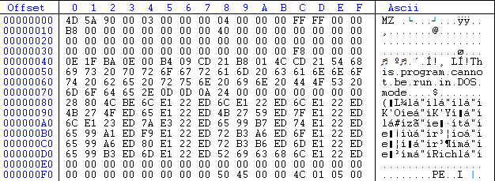
The DOS Header Structure (winnt.h)

Slide 11
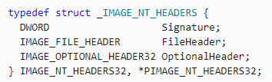
The PE Header
The PE header is the general term for a structure named IMAGE_NT_HEADERS.
Signature: "PE\0\0"
Notes:
The actual structure in WinNT.h is named IMAGE_NT_HEADERS32 and IMAGE_NT_HEADERS is defined as IMAGE_NT_HEADERS32. However, if _WIN64 is defined, then IMAGE_NT_HEADERS is defined as IMAGE_NT_HEADERS64.

Slide 12
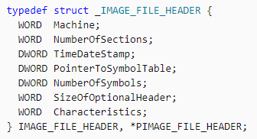
IMAGE_FILE_HEADER structure
20 Bytes

Slide 13
IMAGE_FILE_HEADER structure
Machine: The architecture type of the computer
  0x014c (x86), 0x0200 (Intel Itanium), 0x8664 (x64)
NumberOfSections: The number of sections.
  Note that the Windows loader limits the number of sections to 96.
TimeDateStamp: date and time the image was created by the linker
Notes:
Represents the COFF header format.

Slide 14
IMAGE_FILE_HEADER structure
PointerToSymbolTable: Obsolete
NumberOfSymbols: Obsolete
SizeOfOptionalHeader: The size of the optional header, in bytes. This value should be 0 for object files.

Slide 15
IMAGE_FILE_HEADER structure
Characteristics: The characteristics of the image
  The image is a DLL file
  The image is a system file
  The file is executable (there are no unresolved external references).
  Debugging information was removed and stored separately in another file.
  etc.

Slide 16
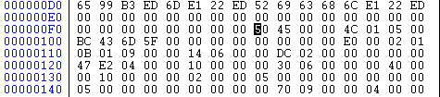
IMAGE_FILE_HEADER structure
Red: PE Signature
Blue: IMAGE_FILE_HEADER structure

Slide 17
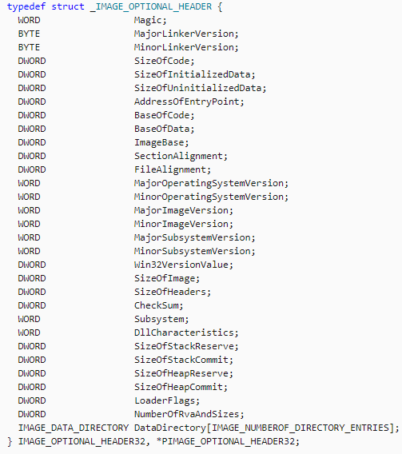
IMAGE_OPTIONAL_HEADER32
96 + 128 = 224 Bytes

Slide 18
IMAGE_OPTIONAL_HEADER32
Magic: The state of the image file; 32-bit or 64-bit or ROM image
SizeOfCode: The size of the code section, in bytes
AddressOfEntryPoint:A pointer to the entry point function, this is the starting address
BaseOfCode:A pointer to the beginning of the code section, relative to the image base.
BaseOfData:A pointer to the beginning of the data section, relative to the image base.

Slide 19
IMAGE_OPTIONAL_HEADER32
ImageBase: The preferred VA of the first byte of the image when it is loaded in memory
SectionAlignment: The alignment of sections loaded in memory, in bytes
FileAlignment:The alignment of the raw data of sections in the image file on the disk
SizeOfImage: The size of the image, in bytes, in memory including all headers. Must be a multiple of SectionAlignment
Notes:
ImageBase
The preferred address of the first byte of the image when it is loaded in memory. This value is a multiple of 64K bytes. The default value for DLLs is 0x10000000. The default value for applications is 0x00400000, except on Windows CE where it is 0x00010000.
SectionAlignment
The alignment of sections loaded in memory, in bytes. This value must be greater than or equal to the FileAlignment member. The default value is the page size for the system.
FileAlignment
The alignment of the raw data of sections in the image file, in bytes. The value should be a power of 2 between 512 and 64K (inclusive). The default is 512. If the SectionAlignment member is less than the system page size, this member must be the same as SectionAlignment.

Slide 20
IMAGE_OPTIONAL_HEADER32
NumberOfRvaAndSizes: The number of entries in the DataDirectory, typically 16
DataDirectory: A pointer to the array of IMAGE_DATA_DIRECTORY structure, 16 elements

Slide 21
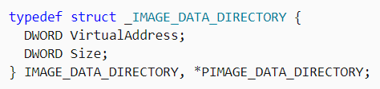
IMAGE_DATA_DIRECTORY structure

Slide 22
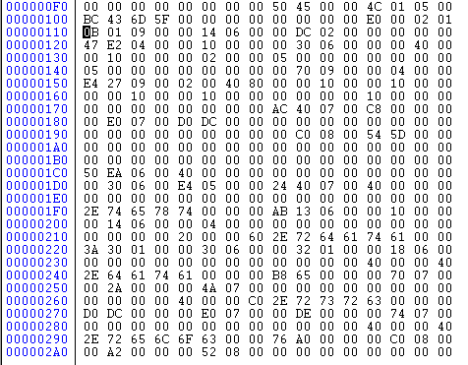
IMAGE_OPTIONAL_HEADER32

Slide 23
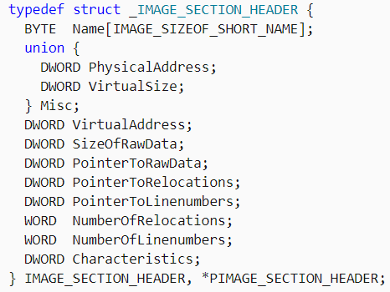
IMAGE_SECTION_HEADER structure
40 Bytes
Notes:
PointerToRelocations
A file pointer to the beginning of the relocation entries for the section. If there are no relocations, this value is zero.

Slide 24
IMAGE_SECTION_HEADER structure
Name: An 8-byte, null-padded UTF-8 string
Misc.VirtualSize: The total size of the section when loaded into memory, in bytes
VirtualAddress: The address of the first byte of the section when loaded into memory, relative to the image base; Multiple of SectionAlignment
SizeOfRawData: The size of the initialized data on disk, in bytes; Multiple of FileAlignment
Notes:
Name: An 8-byte, null-padded UTF-8 string. There is no terminating null character if the string is exactly eight characters long. For longer names, this member contains a forward slash (/) followed by an ASCII representation of a decimal number that is an offset into the string table. Executable images do not use a string table and do not support section names longer than eight characters.

Slide 25
IMAGE_SECTION_HEADER structure
Characteristics: The characteristics of the section
  Read/ Write/ Execute/ Shared/ Discarded/ Not Cached/ Alignment of Data (1,2,,4,8, etc.)
  executable code/ initialized data/ uninitialized data

Slide 26
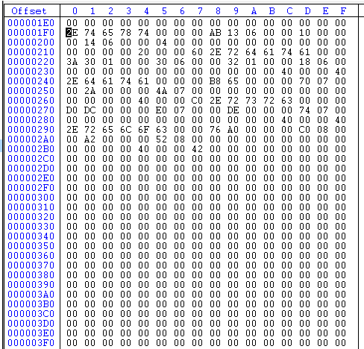
IMAGE_SECTION_HEADER structure

Slide 27
The Export Section
When a DLL exports code or data, it's making functions or variables usable by other EXEs/ DLL.

Slide 28
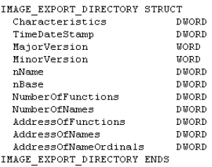
The Export Section
Notes:
Characteristics: Flags for the exports. Currently, none are defined.

Slide 29
The Export Section
nName -- The internal name of the module..
nBase -- Starting ordinal number
NumberOfFunctions -- Total number of symbols exported by this module.
AddressOfFunctions -- the RVAs to all functions in the module are kept in an array, Export Address Table, and this field points to that array.
Notes:
nName -- This field is necessary because the name of
the file can be changed by the user. If that happens, the PE loader will use this internal
name.

Slide 30
The Export Section
AddressOfNames -- An RVA that points to an array of RVAs of the names of functions in the module - the Export Name Table (ENT).
AddressOfNameOrdinals -- An RVA that points to an array that contains the ordinals (16-bit) of the named functions - the Export Ordinal Table (EOT).

Slide 31
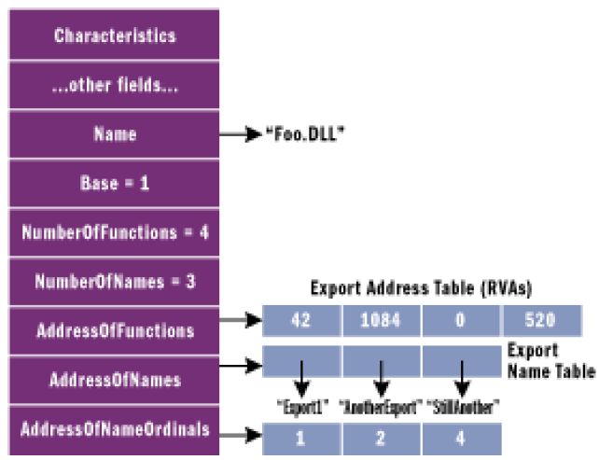
The Export Section

Slide 32
The Export Section
Finding address of a specific function?
Locate IMAGE_EXPORT_DIRECTORY
Search function name in the ENT
Once found in the ENT, read the ordinal from corresponding element in EOT
Use ordinal – base as index in to EAT to find the address of a function

Slide 33
The Import Section
contains information about all the functions imported by the executable from DLLs
Implicit Loading: The Windows loader is responsible for loading all of the DLLs that the application uses and mapping them into the process address space.
Explicit Loading: explicitly during runtime using API calls such as LoadLibrary() or LdrLoadDLL(), and it can resolve the function address using the GetProcessAdress() API.
Notes:
The addresses of functions inside a DLL are not static but change when updated versions
of the DLL are released, so applications cannot be built using hardcoded function
addresses. Because of this a mechanism had to be developed that allowed for these
changes without needing to make numerous alterations to an executable's code at
runtime. This was accomplished through the use of an Import Address Table (IAT). This is
a table of pointers to the function addresses which is filled in by the windows loader as the
DLLs are loaded.
By using a pointer table, the loader does not need to change the addresses of imported
functions everywhere in the code they are called. All it has to do is add the correct address
to a single place in the import table and its work is done.

Slide 34
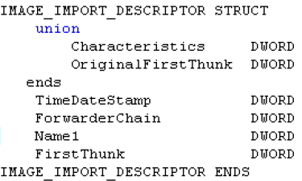
The Import Section
IMAGE_IMPORT_DESCRIPTOR
One for each DLL
Notes:
The end of the IMAGE_IMPORT_DESCRIPTOR array is indicated by an entry with fields all set to 0.

Slide 35
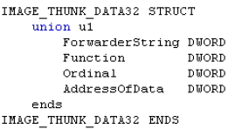

The Import Section
Notes:
DWORD Function; // Memory address of the imported function
DWORD Ordinal; // Ordinal value of imported API
DWORD AddressOfData; // RVA to an IMAGE_IMPORT_BY_NAME with the imported API name
DWORD ForwarderString;// RVA to a forwarder string
The IMAGE_THUNK_DATA structures within the IAT lead a dual-purpose life. In the executablefile, they contain either the ordinal of the imported API or an RVA to an IMAGE_IMPORT_BY_NAMEstructure. The IMAGE_IMPORT_BY_NAME structure is just a WORD, followed by a string naming theimported API. The WORD value is a "hint" to the loader as to what the ordinal of the imported APImight be. When the loader brings in the executable, it overwrites each IAT entry with the actualaddress of the imported function. This a key point to understand before proceeding.
Before the executable is loaded, is there a way you can tell if an IMAGE_THUNK_DATA structurecontains an import ordinal, as opposed to an RVA to an IMAGE_IMPORT_BY_NAME structure? Thekey is the high bit of the IMAGE_THUNK_DATA value. If set, the bottom 31 bits (or 63 bits for a 64-bit executable) is treated as an ordinal value. If the high bit isn't set, the IMAGE_THUNK_ DATAvalue is an RVA to the IMAGE_IMPORT_BY_NAME. The other array, the INT, is essentially identical to the IAT. It's also an array ofIMAGE_THUNK_DATA structures. The key difference is that the INT isn't overwritten by the loaderwhen brought into memory. Why have two parallel arrays for each set of APIs imported from aDLL? The answer is in a concept called binding. When the binding process rewrites the IAT in thefile (I'll describe this process later), some way of getting the original information needs to remain.The INT, which is a duplicate copy of the information, is just the ticket. An INT isn't required for an executable to load. However, if not present, the executable cannotbe bound. The Microsoft linker seems to always emit an INT, but for a long time, the Borland linker(TLINK) did not. The Borland-created files could not be bound.

Slide 36
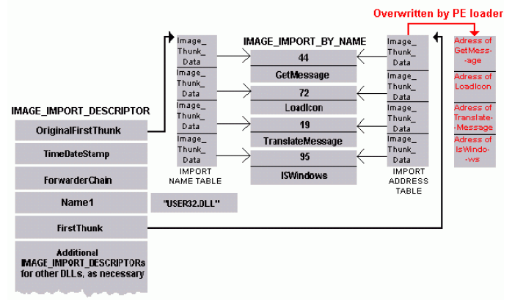
The Import Section

Slide 37
PE Section Table And Sections
sections represent either code or data
code section contains instructions
section names are mainly for humans and are not used by the operating system

Slide 38
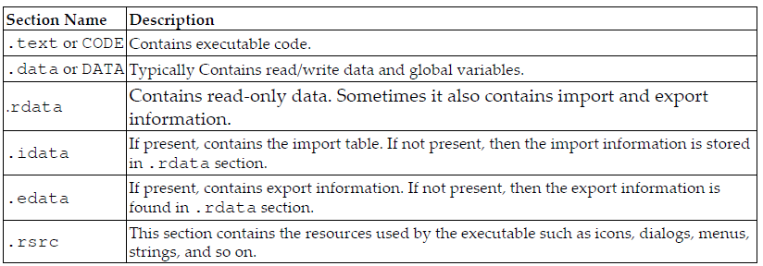
PE Section Table And Sections

Slide 39
Examining PE Resources
The resources required by the executable file such as icons, menu, dialog, and strings are stored in the resource section (.rsrc) of an executable file.
Often, attackers store information such as additional binary, decoy documents, and configuration data in the resource section
The resource section also contains version information that can reveal information about the origin, company name, program author details, and copyright information.

Slide 40
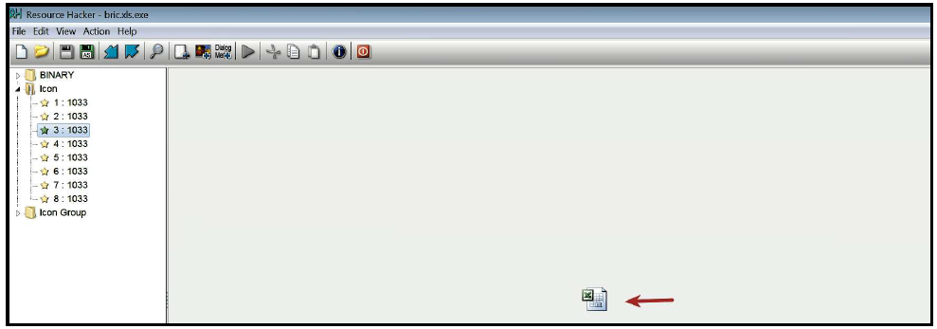
Resource Hacker
great tool to examine, view, and extract the resource from a suspect binary.
Notes:
-uses the icon of Microsoft Excel

Slide 41
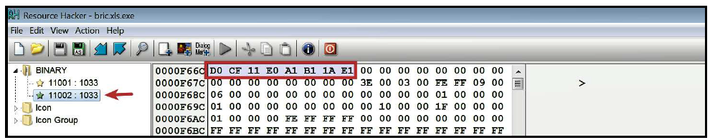
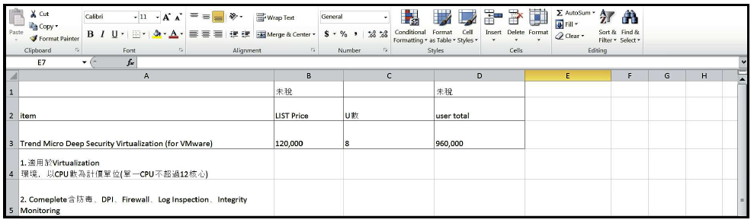
Resource Hacker
Notes:
The executable also contains binary data; one of them has a file signature of D0 CF 11 E0
A1 B1 1A E1. This sequence of bytes represents the file signature for a Microsoft Office
document file. The attackers, in this case, stored a decoy excel sheet in the resource section.
Upon execution, the malware is executed in the background, and this decoy excel sheet is
displayed to the user as a diversion:

